Slide 1

Artificial Intelligence in Finance Multilayer Perceptron in R
Hadi Movaghari
2022-2023

Slide 2
Outline
General idea on MLP
Script file
Importing data
Summarizing data
Visualizing data
Standardizing Data
Splitting data
The package
Fitting the model
Out-of-sample prediction
Artificial Intelligence in Finance: MLP in R
University of Glasgow
2022-2023

Slide 3
General idea on MLP
Neural networks (NN) are important standard machine learning procedures for classification and regression.
Multi-layer perceptrons (MLP) of Rosenblatt (1958) is a type of NN. Other types include self-organizing map (SOM), learning vector quantization (LVQ) , radial basis function (RBF), etc.
These types differ in the manner of operation, architecture, and learning.
An MLP consists of:
Input layers: Layers that take inputs based on existing data
Hidden layers: Layers that use backpropagation to optimise the weights of the input variables in order to improve the predictive power of the model
Output layers: Output of predictions based on the data from the input and hidden layers
Artificial Intelligence in Finance: MLP in R
University of Glasgow
2022-2023

Slide 4
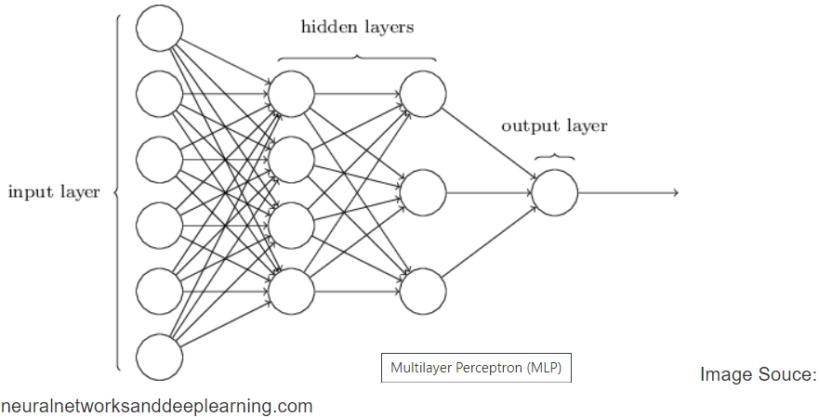
General idea on MLP (Cont’d)
Artificial Intelligence in Finance: MLP in R
University of Glasgow
2022-2023

Slide 5
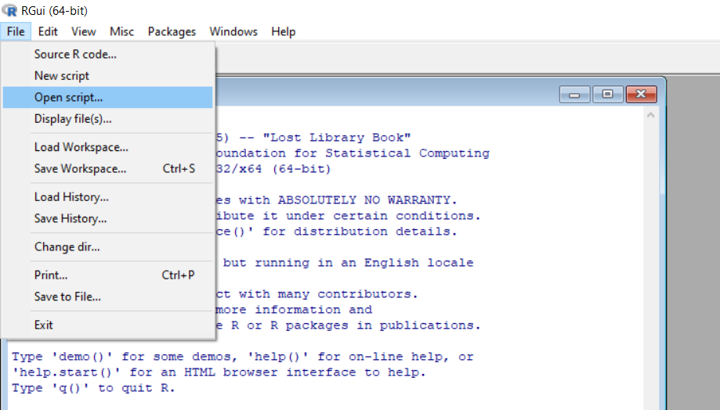
Open your script file!
Download files (script, data, PowerPoint) from Moodle or https://github.com/hadigilan/AIFinance_tutorial1.git
From File -> Open script find your file and then open
Artificial Intelligence in Finance: MLP in R
University of Glasgow
2022-2023

Slide 6
Part 1: Importing data
Personal loan information to predict the credit scores.
Independent variables:
int.rate: The interest rate of the loan. Borrowers judged by LendingClub.com to be riskier are assigned higher interest rates.
installment: The monthly installments owed by the borrower if the loan is funded.
log.annual.inc: The natural log of the self-reported annual income of the borrower.
dti: The debt-to-income ratio of the borrower (amount of debt divided by annual income).
Dependent variable: fico (credit score of the borrower)
Artificial Intelligence in Finance: MLP in R
University of Glasgow
2022-2023

Slide 7
Part 1: Importing data (Cont’d)
We assume that your data format is csv
mydata <- read.csv("C:/loan.csv")
read.csv is a function to read csv files.
Put the path of your file between “ “
Use // or \ to separate paths.
Artificial Intelligence in Finance: MLP in R
University of Glasgow
2022-2023

Slide 8
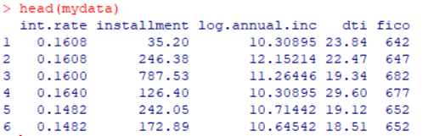
Part 1: Importing data (Cont’d)
To see the first rows of data
head(mydata)
head is a function to show the first elements of each objects
To see the last rows of data
tail(mydata)
To see the dimensions of data
dim(mydata)
Our data has 1868 rows (observations) and 5 columns (variables)
Artificial Intelligence in Finance: MLP in R
University of Glasgow
2022-2023

Slide 9
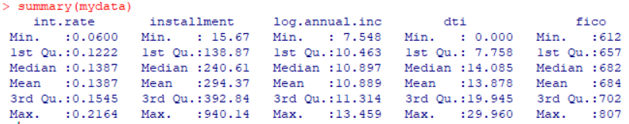
Part 2: Summarizing data
To see descriptive statistics of data
summary(mydata)
summary is a function which produces min, max, mean, median, first and third quartiles. It doesn't give SD.
Artificial Intelligence in Finance: MLP in R
University of Glasgow
2022-2023

Slide 10
Part 2: Summarizing data (Cont’d)
To produce the standard deviation
apply(mydata, 2, sd)
apply, lapply, sapply, tapply are functions to make the operations easier.
the argument 2 refers to column. You can produce sd for each row by argument 1 (But it doesn’t mean!)
sd is a built-in function to calculate standard deviation
Artificial Intelligence in Finance: MLP in R
University of Glasgow
2022-2023

Slide 11
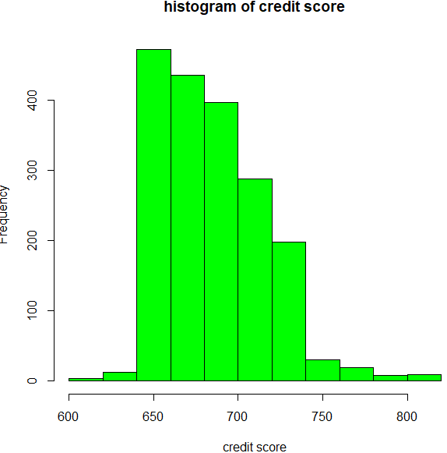
Part 3: Visualizing Data
To produce a histogram plot
hist(mydata$fico, xlab="credit score", col="green",
main="histogram of credit score")
hist is a built-in function to produce histogram plot
xlab argument to determine the x-axis label.
col to change the colour
main argument to change the title of the figure
put names between “ ”
Artificial Intelligence in Finance: MLP in R
University of Glasgow
2022-2023

Slide 12
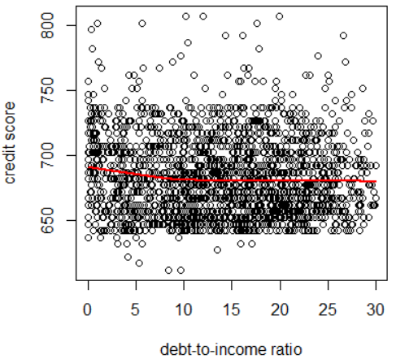
Part 3: Visualizing Data (Cont’d)
To produce a scaterplot
plot(mydata$dti, mydata$fico, xlab="debt-to-income ratio", ylab="credit score")
lines(lowess(mydata$dti, mydata$fico), col="red", lwd=2)
lowess fits a smooth curve (It is a good technique
to discover patterns in data)
lines add the smooth curve to existing plot
lwd changes the thickness of the line plot
Artificial Intelligence in Finance: MLP in R
University of Glasgow
2022-2023

Slide 13
Part 4: Standardizing Data
Neural networks work best when the data are standardized.
To standardize the variables:
mydata.scaled <- scale ( mydata )
scale is a built-in function to scale data
Artificial Intelligence in Finance: MLP in R
University of Glasgow
2022-2023

Slide 14
Part 4: Standardizing Data (Cont’d)
We standardized input variables. Thus, they must have 0 mean and 1 standard deviation. To check this:
apply(mydata.scaled , 2, sd)
apply(mydata.scaled , 2, mean)
We also can use max-min technique to standardize data
Artificial Intelligence in Finance: MLP in R
University of Glasgow
2022-2023

Slide 15
Part 5: Splitting data
To learn a neural network, we need to split data into training and test set.
Because it is important to have a model which works well for unseen data- the out-of-sample prediction
The training set is used to learn the model. The test set is used to prediction.
Artificial Intelligence in Finance: MLP in R
University of Glasgow
2022-2023

Slide 16
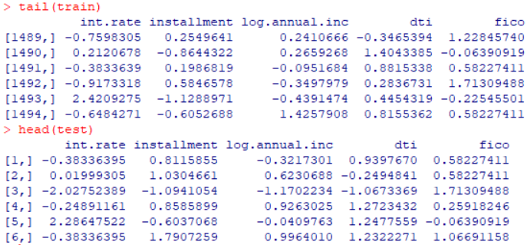
Part 5: Splitting data (Cont’d)
We put 80% of our data into training set and the remaining 20% into test set:
train.index <- 0.8 * nrow( mydata.scaled )
train<- mydata.scaled [1:train.index , ]
test<- mydata.scaled [train.index:nrow(mydata.scaled),]
tail(train)
head(test)
nrow is a built-in function which shows the
number of rows in a data.frame or matrix
Artificial Intelligence in Finance: MLP in R
University of Glasgow
2022-2023

Slide 17
Part 6: The package
We use ‘neuralnet’ package
install.packages("neuralnet")
library(neuralnet)
You can download the manual of the package from https://cran.r-project.org/web/packages/neuralnet/neuralnet.pdf
You can cite the package in your publication
citation("neuralnet")
Artificial Intelligence in Finance: MLP in R
University of Glasgow
2022-2023

Slide 18
Part 7: Fitting the model
To fit a neural networks model with 2 neurons in the hidden layer:
fit <- neuralnet(fico ~ int.rate + installment + log.annual.inc + dti, data = train, hidden = 2)
data is the argument that introduces the data.frame containing inputs and output
hidden is a vector of integers specifying the number of hidden neurons (vertices) in each layer. For example, hidden = c(2,3) fit a model with 2 and 3 neurons in the first and second layer, respectively.
Artificial Intelligence in Finance: MLP in R
University of Glasgow
2022-2023

Slide 19
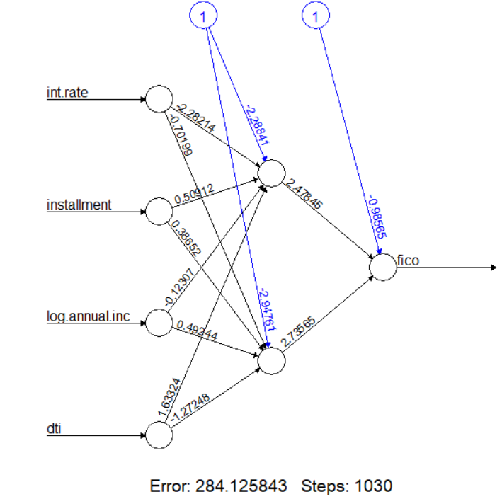
Part 7: Fitting the model (Cont’d)
To plot the fitted model:
plot(fit)
fit is the name of fitted model
Artificial Intelligence in Finance: MLP in R
University of Glasgow
2022-2023

Slide 20
Part 8: out-of-sample prediction
prediction<- predict(fit, newdata=test)
predict is a built-in function for prediction
fit is the name of fitted model
newdata is the argument that introduces the dataset used for prediction
Artificial Intelligence in Finance: MLP in R
University of Glasgow
2022-2023

Slide 21

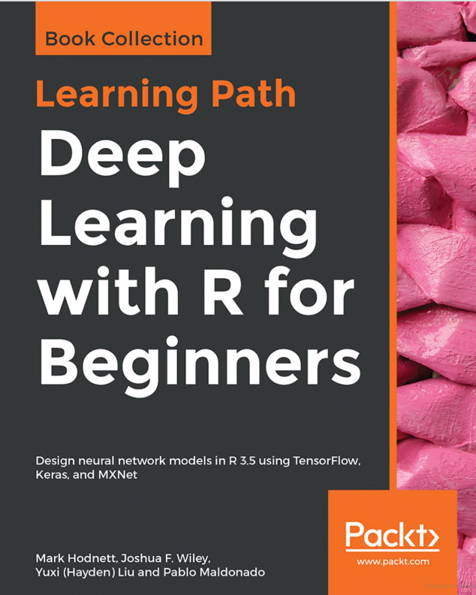
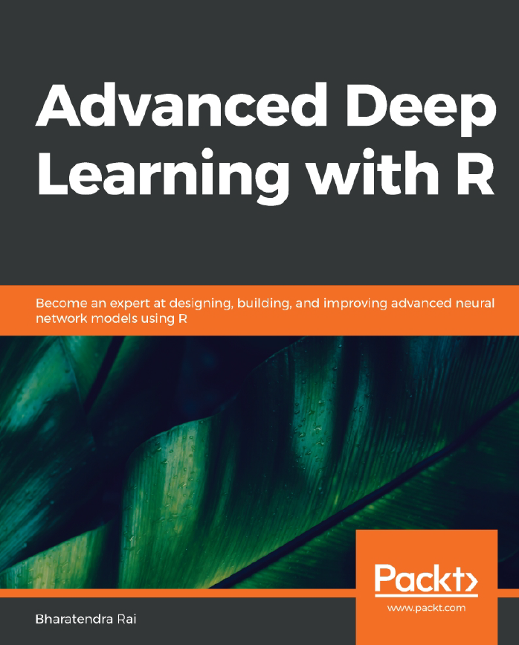
Bibliography
Available online in the library
Artificial Intelligence in Finance: MLP in R
University of Glasgow
2022-2023

Slide 22
Contact
If you have any question regarding R programming and financial econometrics, or any suggestion to improve the teaching style, please feel free to contact me through:
Hadigilan@gmail.com
Artificial Intelligence in Finance: MLP in R
University of Glasgow
2022-2023

